Slide 1

Front End Engineering-II
Project Report
Semester-III (Batch-2023)
Leviathan Drones
Supervised by: Submitted By:
Thirupathy M Harsainyam Singh(2310991840)
Kavita Sharma(2310991868)
Keshav Bhalla(231009869)
L Manjila Singha(2310991881)
Department of Computer Science and Engineering
Chitkara University Institute of Engineering & Technology,
Chitkara University, Punjab

Slide 2

Abstract
The Leviathan Drones project focuses on the development of a comprehensive website designed to showcase our innovative underwater drones. The website serves a dual purpose: to educate users on the assembly and operation of these drones through detailed tutorials, and to provide a platform for the future sale of our products and their components.
Our goal is to create an intuitive, user-friendly website using HTML and CSS, emphasizing responsive design to ensure accessibility across various devices. By combining educational content with an e-commerce section, the website aims to attract a diverse audience, from hobbyists to professionals in underwater exploration. This presentation outlines the structure, features, and expected outcomes of the Leviathan Drones website, highlighting its potential to serve as both an educational resource and a commercial platform.

Slide 3
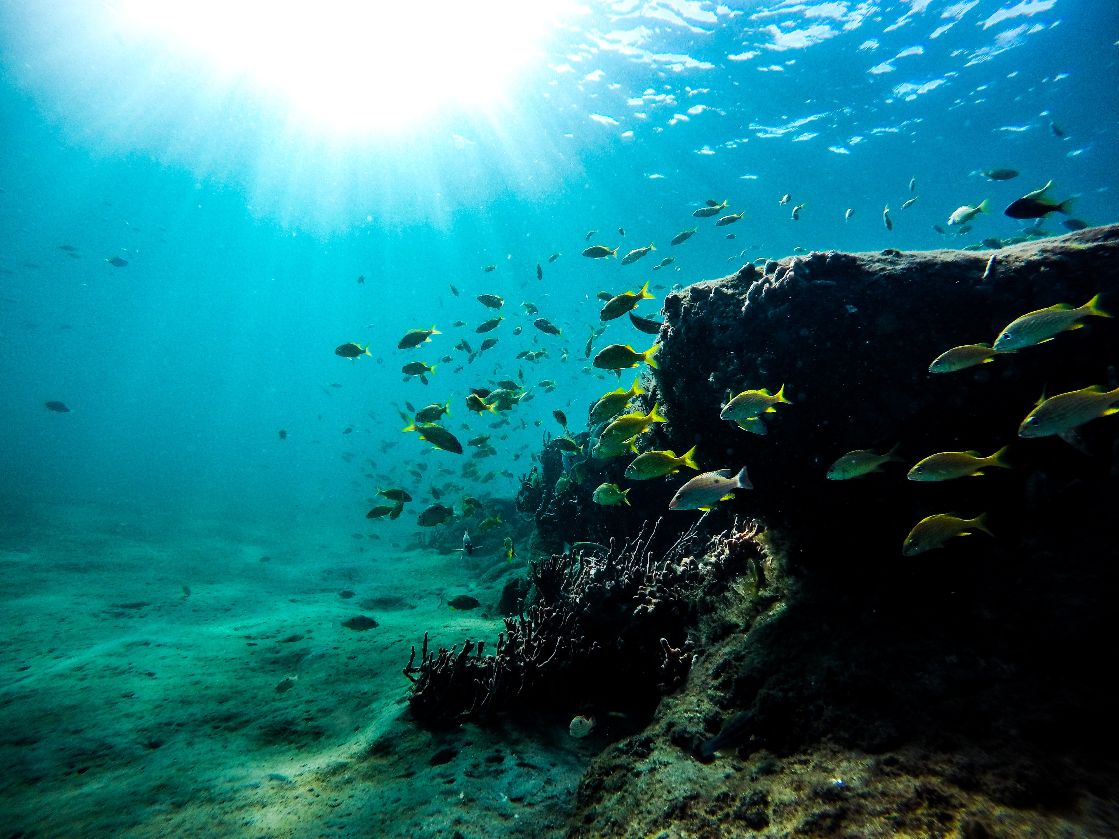
Table Of Contents
Introduction
Problem Definition and Requirements
Modules
Results
Conclusions
References

Slide 4

Introduction
Background:
Leviathan Drones is a pioneering project focused on the design and development of underwater drones. These drones are engineered for various applications, including marine exploration, research, and underwater photography. The project was initiated to get affordable underwater technology, offering a versatile tool for both hobbyists and professionals and learning enthusiasts.
As underwater environments pose unique challenges, Leviathan Drones are built to withstand extreme conditions while providing high-quality performance. The need for a dedicated online platform became apparent to not only showcase the capabilities of these drones but also to educate users on their construction and operation.

Slide 5

Objectives:
Showcase the Drones: To create an engaging online presence where potential users and buyers can learn about the different models of Leviathan Drones, their features, and their applications.
Educate and Empower: To develop a comprehensive tutorial section within the website, featuring step-by-step guides, videos, and resources that teach users how to assemble and operate the drones.
E-commerce Platform: To lay the groundwork for an e-commerce section where the drones and their components can be sold, making the technology more accessible to a wider audience.

Slide 6
Significance:
The Leviathan Drones website is more than just a digital brochure; it is a hub for knowledge, innovation, and commerce in the underwater technology sector. By providing detailed tutorials and an accessible platform for purchasing drone parts, the website supports the growing community of underwater drone enthusiasts and professionals.
This project not only contributes to the advancement of underwater exploration tools but also opens up new educational opportunities for users around the world.
This website will be a valuable resource for anyone interested in underwater drones, whether they are looking to purchase, learn, or contribute to the field of marine technology.

Slide 7

Problem Statement
As underwater exploration and research continue to grow in importance, there is a clear need for reliable, accessible, and versatile underwater drones. However, the lack of a comprehensive budget based online platform that educates users on how to assemble and operate these drones presents a significant challenge.
Additionally, there is a market gap for a dedicated platform where such drones and their components can be purchased.
The Leviathan Drones website aims to address these issues by offering a robust solution that combines education, product showcasing, and e-commerce.

Slide 8
Software Requirements
To build the Leviathan Drones website, the following software tools and technologies are Used:
HTML5: The backbone of the website, providing the structure and content organization.
CSS3: Used for styling the website, ensuring a visually appealing and consistent design across all pages.
JavaScript (optional): For adding interactive elements and enhancing user experience (e.g., video players, dynamic forms).
Responsive Design Frameworks: Such as Bootstrap, to ensure the website is accessible and functional across various devices (desktops, tablets, smartphones).
Web Hosting: A server to host the website, ensuring it is accessible to users worldwide.

Slide 9
Hardware Requirements
In addition to the software, specific hardware components are essential for the development, testing, and deployment of the website:
Development Machines: Computers with sufficient processing power, memory, and storage to handle web development tasks.
Testing Devices: A variety of devices (e.g., desktops, laptops, tablets, smartphones) to test the responsiveness and compatibility of the website.
Server: A web server for hosting the website, with enough bandwidth and storage to manage traffic and data (e.g., images, videos).
Networking Equipment: Reliable internet connection and networking tools for seamless development and deployment processes.

Slide 10
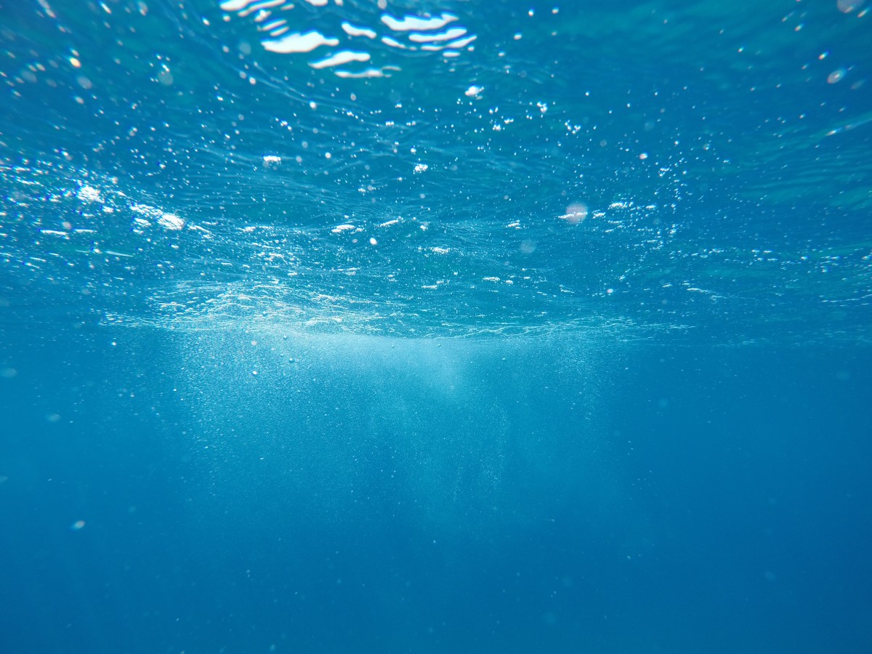
Modules
1. Home/Feed Page
Navigation Bar
Link to home page, About, How it works ,Tutorial, Showcase ,Shop, Contact.
Website name.
Feed
Underwater theme with text, images.
Engagement buttons: Explore, Shop.
Footer section :Copyright reserved logo, privacy policy, terms of service.
Parallax effect used in background .
Animation and highlights in heading.
Key features mentioned.
2. About Page
1.Heading
Animated heading with animated background.
Highlighted subheading with content
2. Content
Drone image with animated zooming effect.
Feedback from our clients.

Slide 11
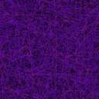
How it works page.
Heading
Heading with an underwater theme background.
Key features
Features provided in our drone.
Shop Now Button
Footer section
Copyright reserved logo, privacy policy, terms of service.
Tutorials Page
Heading
Animated underwater theme background with heading .
Planning section
Comprehensive planning on building the drones using css for enhancement.
Live effect images of components required.
Link directed to shop for component purchase.
5. Showcase Page
Live effect underground background.
Animated color changing Explore button.
Images of drones with a learn more button.
3D shadow effect images.

Slide 12
6. Contact Pages:
3d effect form
With hover effect
Popping sending message
7. Login/Signup Page:
Login Page
Username/Email & Password Fields
Remember Me Checkbox
Forgot Password Link
Login Button
Social Login Options
Error Messages
Redirect to Signup

Slide 13

7. Signup Page:
Username, Email, Password & Confirm Password Fields
Terms and Conditions Checkbox
Signup Button
Social Signup Options
Email Verification
Error Handling
8. Help page.
• Search Bar: Quick access to relevant help topics.
• FAQs: Common questions with instant answers.
• Support Categories: Organized help by topics (e.g., Account, Billing).
• Contact Options: Email, chat, or phone support.
• Guides: Step-by-step tutorials.

Slide 14
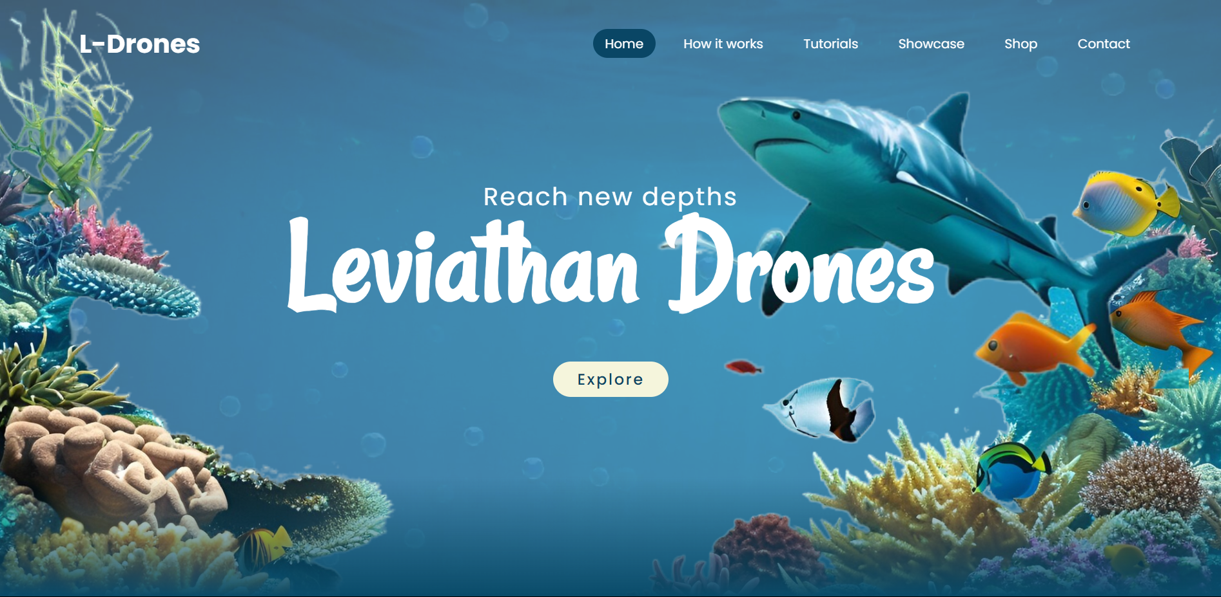
Screenshots

Slide 15
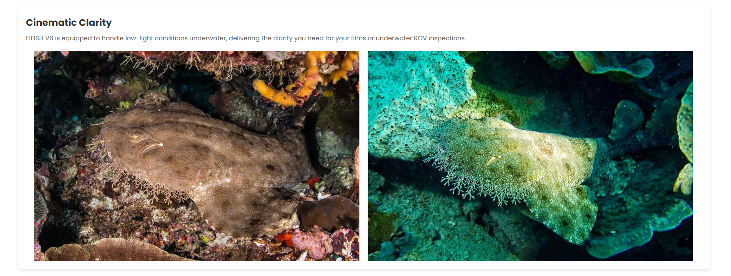

Slide 16
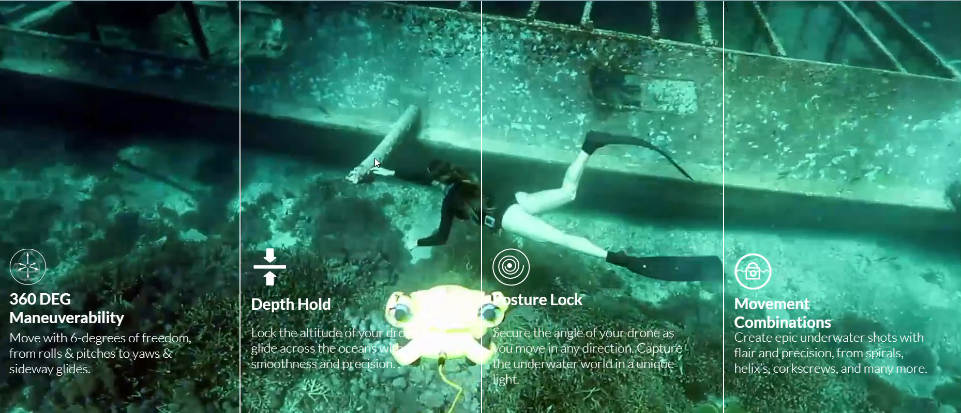
Properties -:

Slide 17
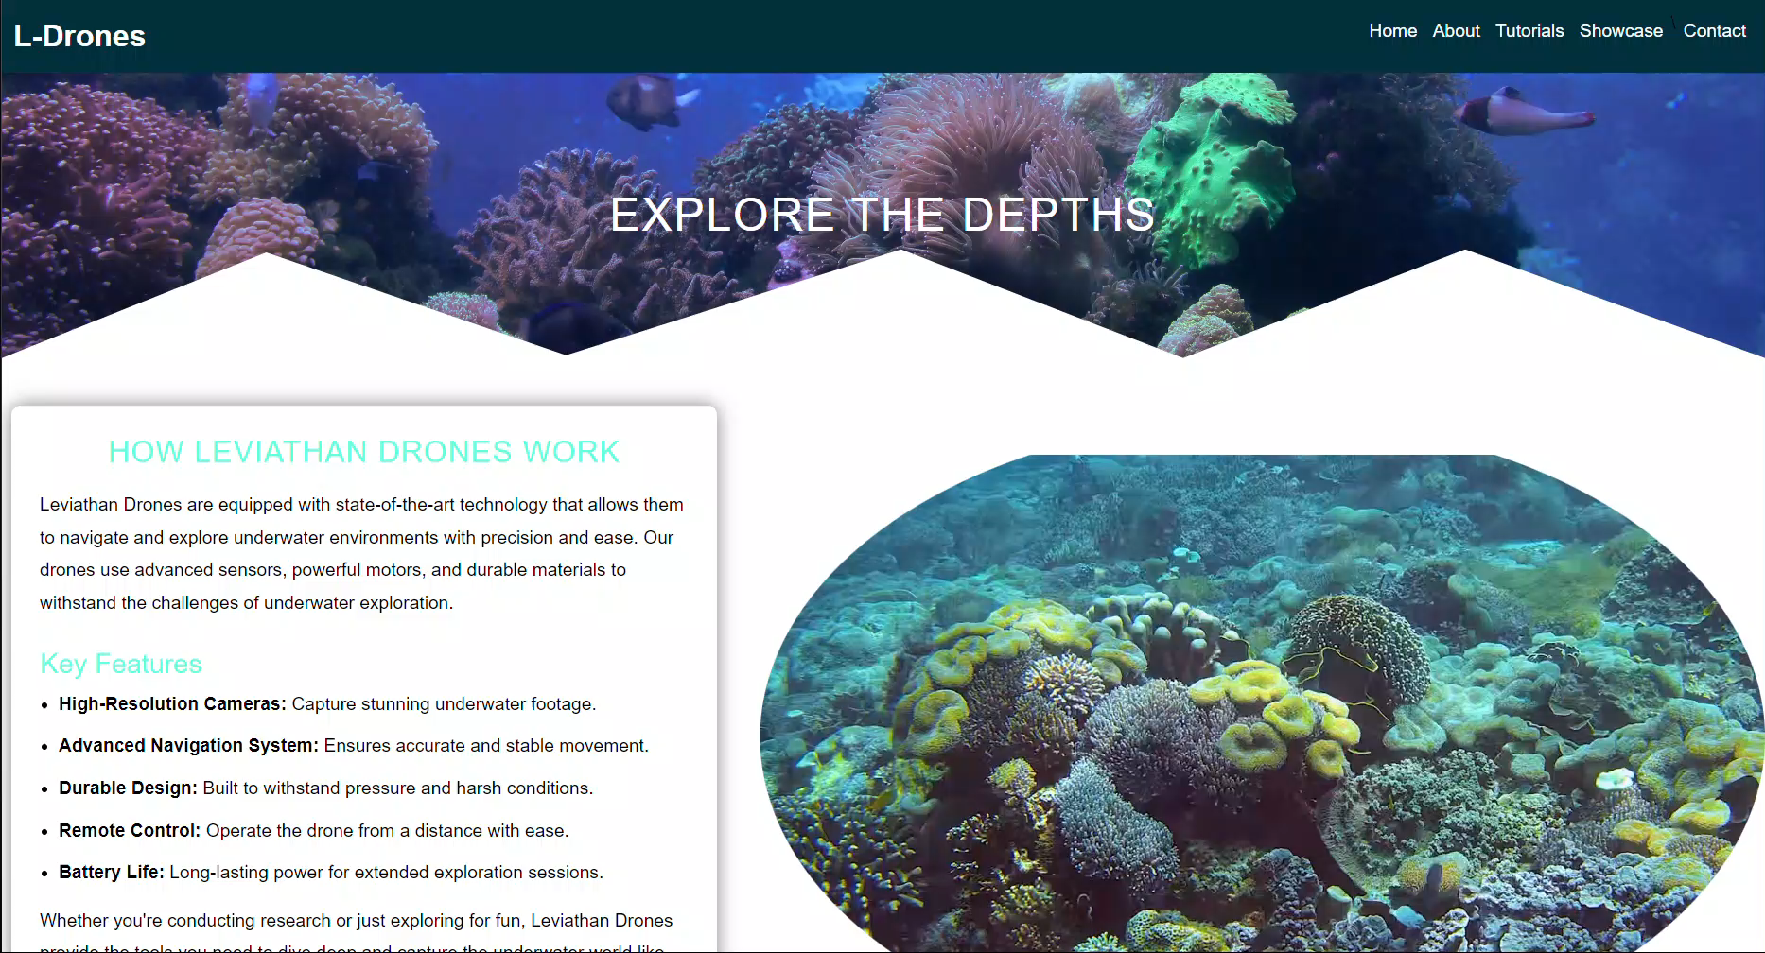
How It Works -:

Slide 18
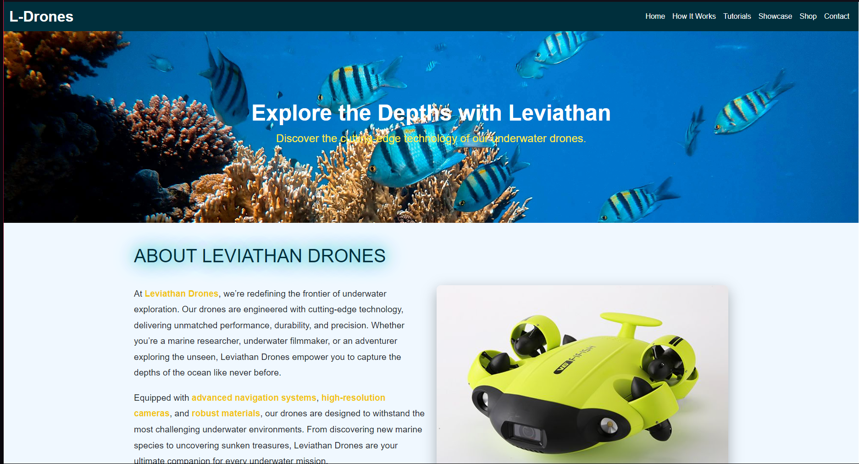
About Us -:

Slide 19
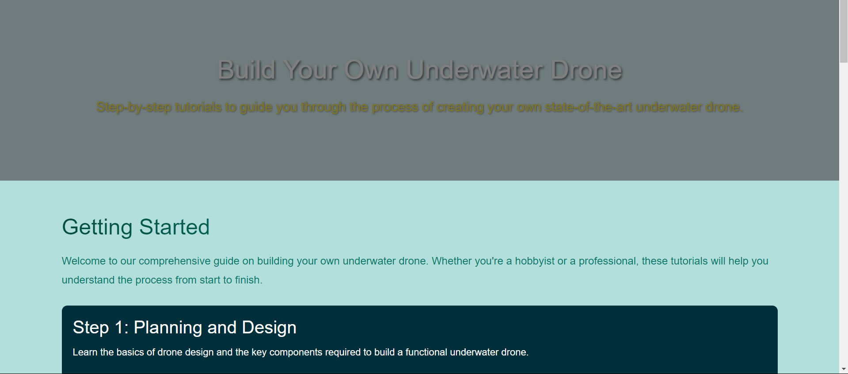

Slide 20
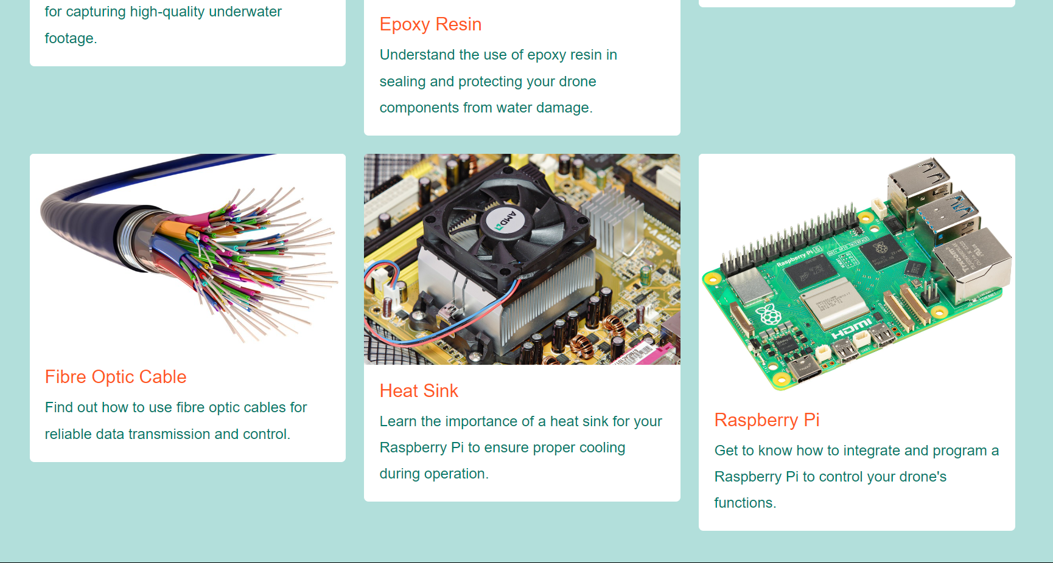

Slide 21
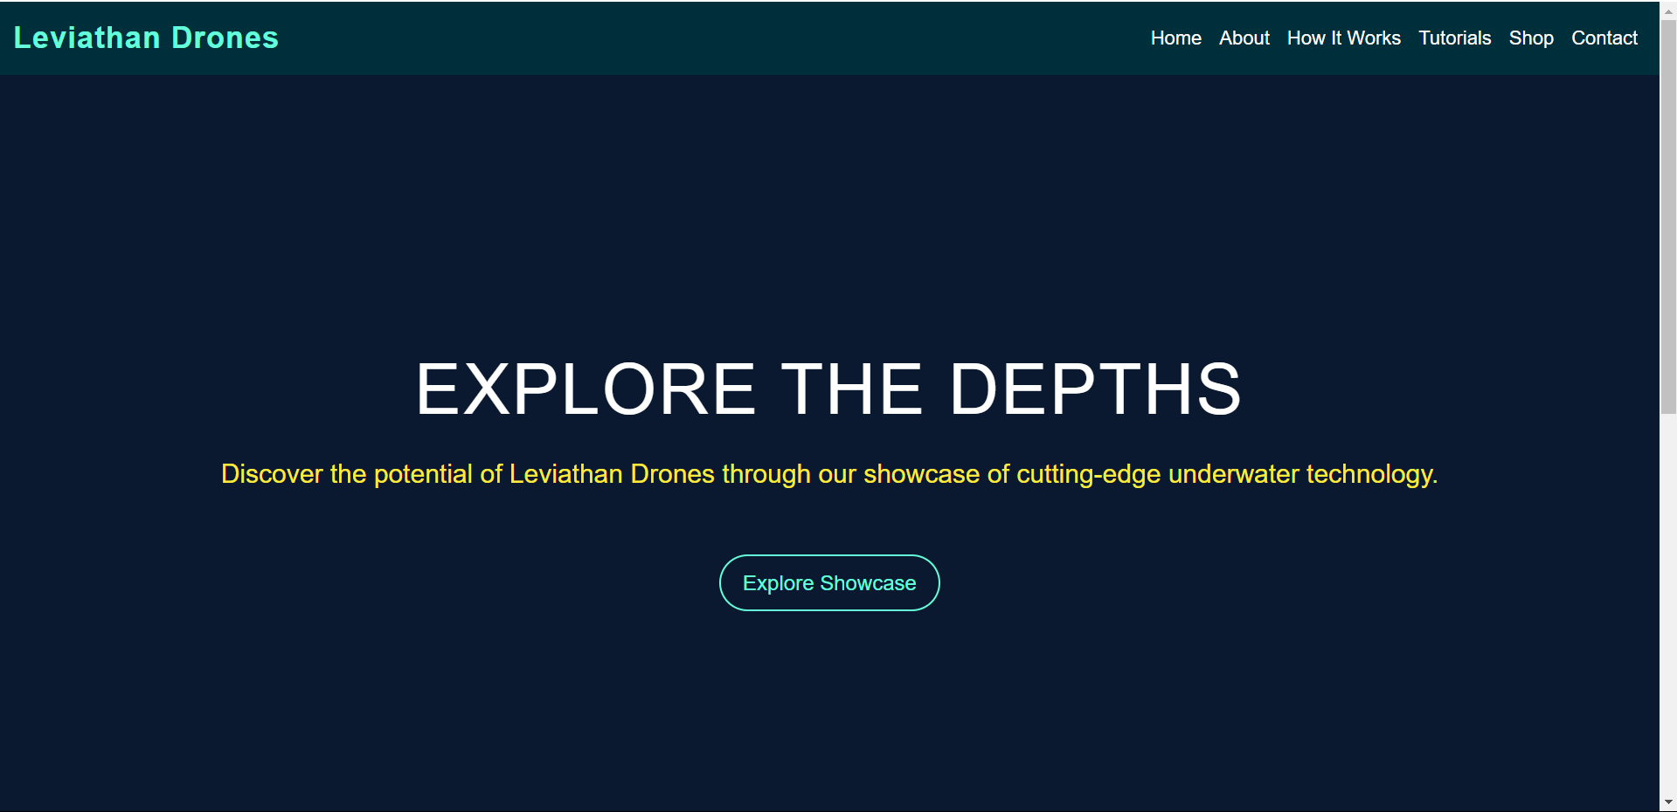

Slide 22
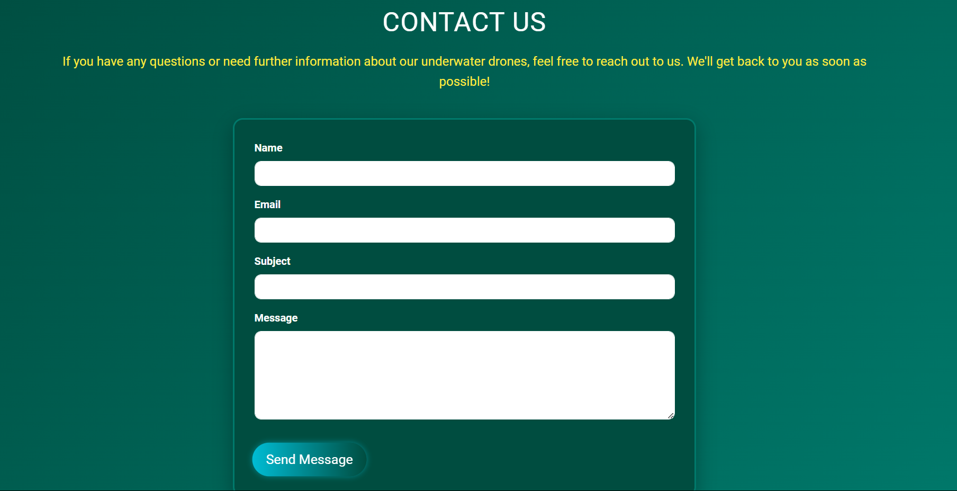

Slide 23

Conclusions
The Leviathan Drones website successfully showcases our innovative underwater drones while providing educational resources to users. With a focus on user experience through responsive design and clear structure, the website serves as both an informative platform and a foundation for future e-commerce opportunities. This project not only enhances the visibility of Leviathan Drones but also supports the growth of the underwater exploration community, positioning us for future advancements.

